Slide 1
Introduction To Video Games
Mack 2023

Slide 2
What’s the Purpose?
To create an engaging experience for the player.
To turn your vision into a working game.

Slide 3
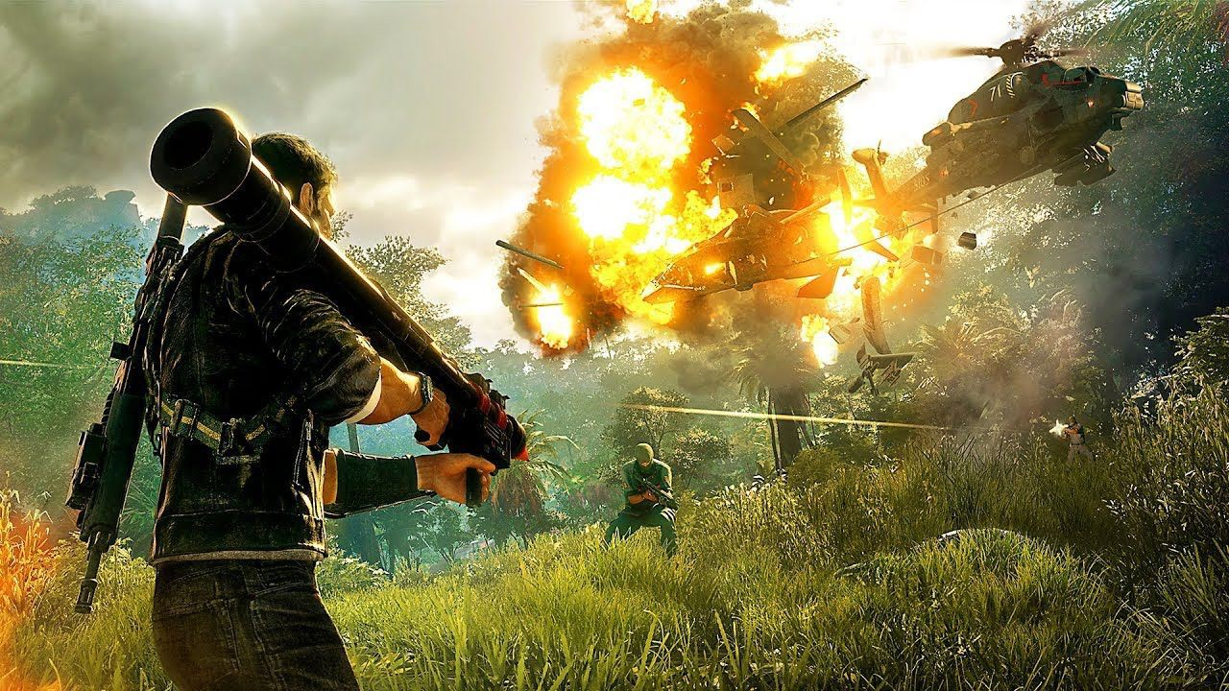
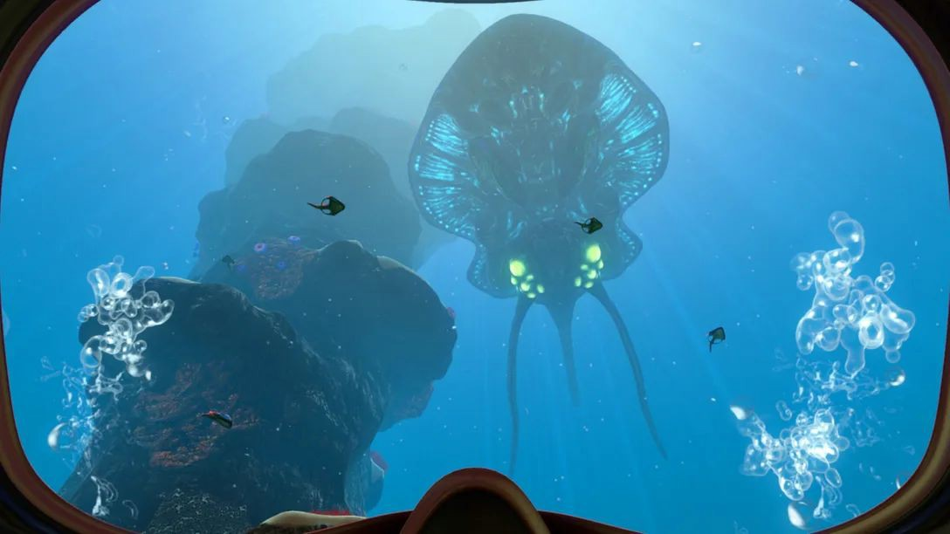
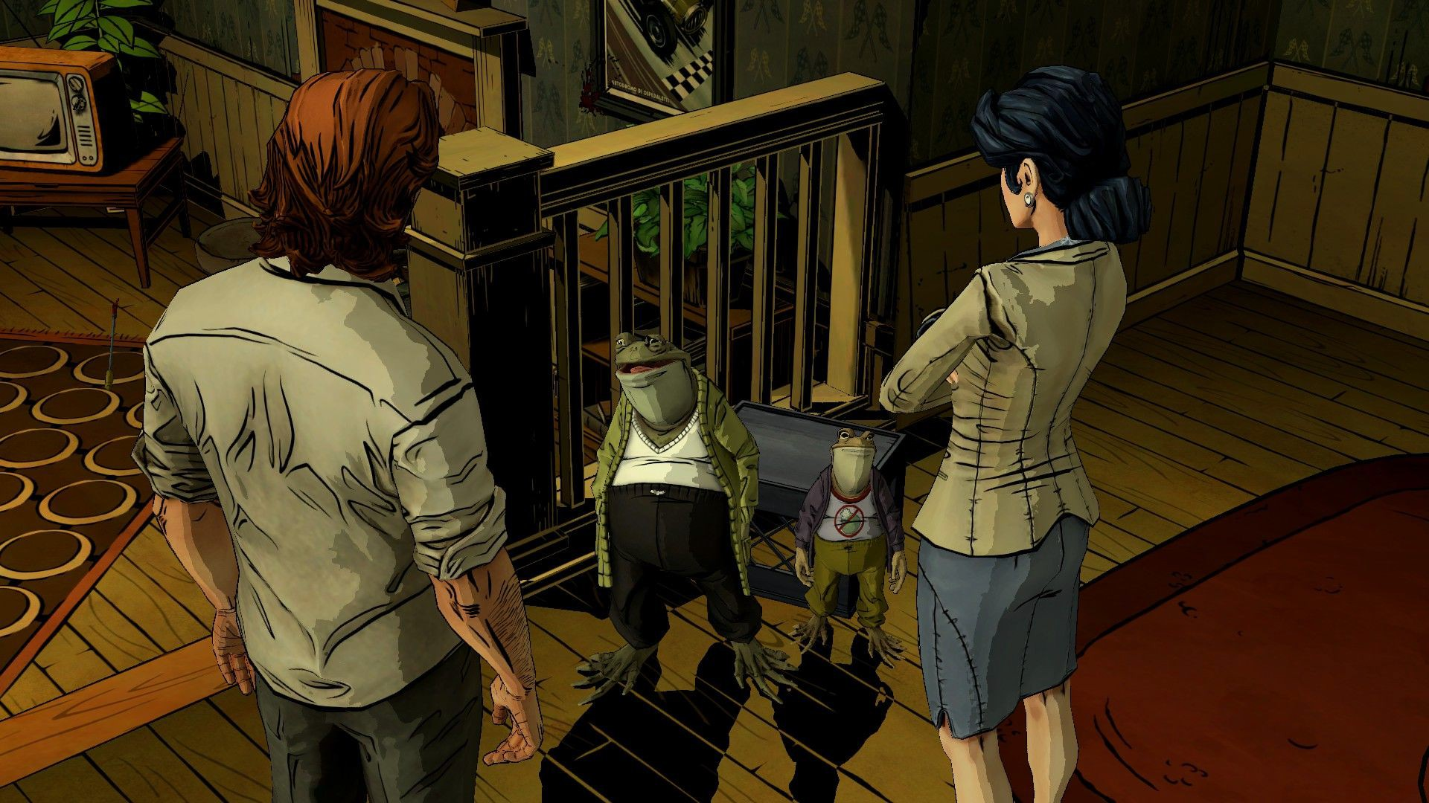
What Will We Cover?
Creating the Game Idea
Experience
Goals
Systems
Core Game Loop
Guiding the Player
Game Feel
Teaching the Player

Slide 4
Creating a Game Idea

Slide 5
Core Mechanic
When starting out, you want to keep your ideas simple.
To do this, you need to think of a core mechanic.
Notes:
When starting a new game, the tricky thing is to figure out the Game idea. What will the game be,
what is the player going to do, and how are they going to do it? The best way to tackle these
problems is to keep your ideas as simple as possible. And to do this, you need to think of a core
mechanic.

Slide 6
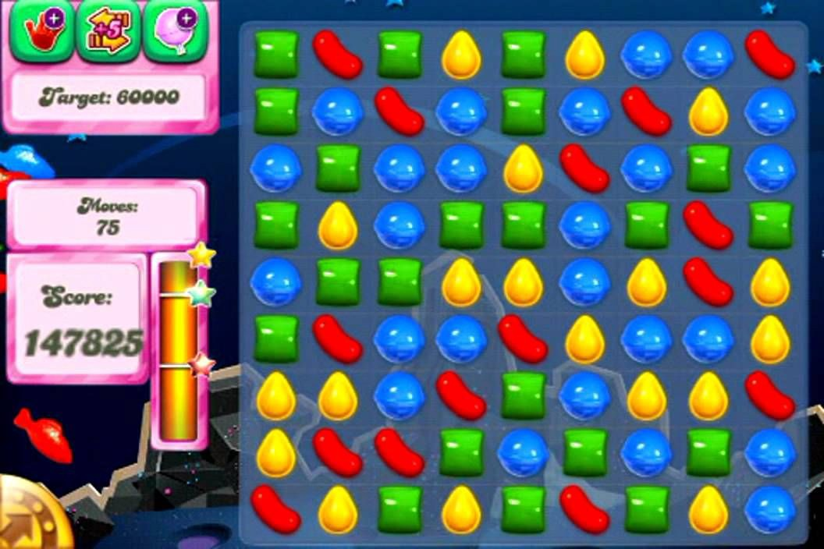
What is a Core Mechanic?
The action of play which makes the gameplay.
This is the main thing that the player does throughout the game.

Slide 7
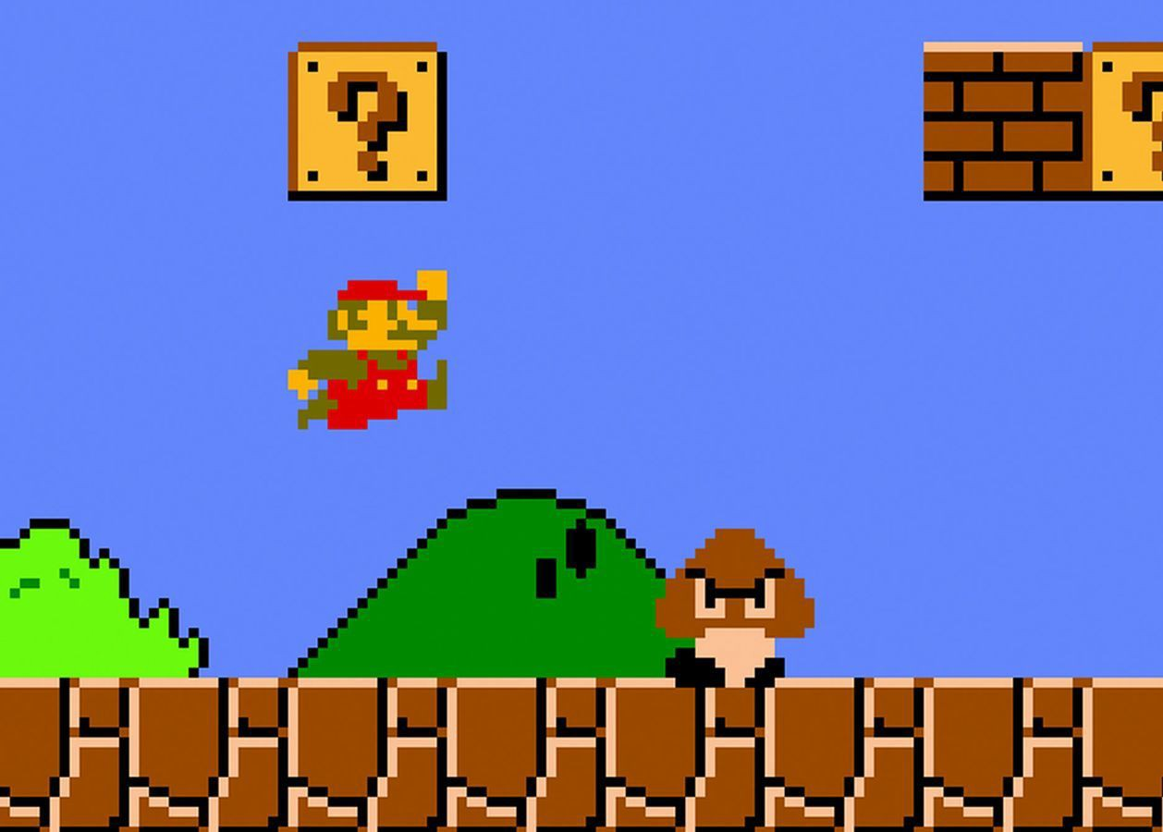
Example: Super Mario Bros
The core mechanic is jumping.
You jump to:
Defeat enemies.
Hit blocks.
Avoid obstacles.
To end the level.
Notes:
At its core, Mario is a character who can run and jump around. We can begin adding in systems that
can utilize this core mechanic, such as adding obstacles to jump over, making destroyable blocks,
hitting enemies by jumping on them, etc.

Slide 8

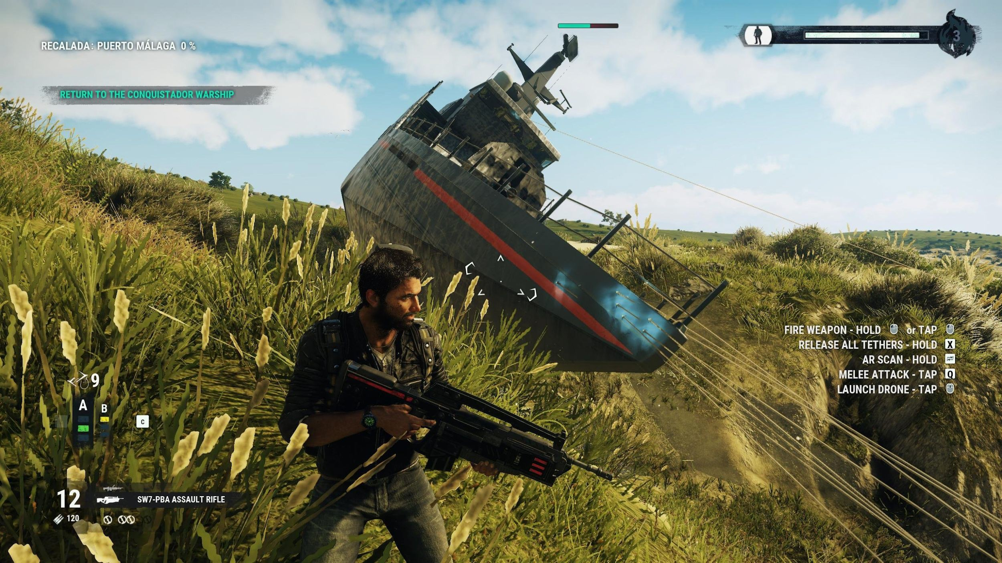
Example: Just Cause Games
The core mechanic is your grappling hook.
Move around.
Access vehicles.
Defeat enemies.
Move around objects.

Slide 9
Why Have a Core Mechanic?
Games with a core mechanic have a very ﬂexible scope.
This is great for smaller games.
Notes:
When starting a new game, you don’t want to go overboard thinking of all the new things you can
implement and then overwhelm yourself eventually.
Having a core mechanic in your game means you can focus all of your attention on a single system
that you can refine and iterate upon. It can make game development much easier, and expanding
from the core mechanic is definitely something you should have in mind.

Slide 10




Why Have a Core Mechanic?
Add obstacles to
jump over.
Defeat enemies by
jumping on them.
Mario can run and
jump around.
Hit blocks by
jumping into them.
Jump on the ﬂag to ﬁnish the level.

Slide 11
Want to Learn More?
[Book] The Art of Game Design by Jesse Schell
[Web] Designing Around a Core Mechanic by Gamasutra
[Web] Random Game Idea Generator by Indie Game Dev

